Slide 1
World Happiness Comparison and Contributing Factors
Marbella Elpantja
25/05/2024

Slide 2
Table of Contents
01
02
03
04
Objective
The purpose of this data analytics project
Data Collection and Analysis
Data source
Analysis process
Data Presentation
Visuals
Key takeaways during analysis
Conclusion and Recommendation
Overall data story
Further recommendation
Notes:
Objective : Identify the goal of this data analytics project
Data Collection and Analysis Process :
Give background information regarding what the dataset is about, where and when is it from, and why it is chosen
Explain briefly the metrics used in the analysis project. Metrics are specific quantifiable data collected from the raw dataset that is put in context based on the goal of the project
Data Presentation :
Present the data visuals and explain the key takeaways from every visual in a logical manner
Conclusion and Recommendation:
Summarize the overall key takeaways from this analysis project
Provide recommendation for areas that need further exploration

Slide 3
Objective
Identify if there are components of demographicsthat contribute to a country’s happier life.
Statistically quantify the relationship between happiness of a country to significant aspects of demographics
Notes:
Demographics are statistics used to describe the characteristics of a given population, such as country or a region. Aspects of demographics include income and education level, social and cultural values, or birth and mortality rates.
Use statistical methods systematically to analyze the data and summarize any trends or key insights.

Slide 4

Data Collection Data Analysis y

Slide 5
Data Collection
Source : World Happiness Report, Kaggle
https://www.kaggle.com/datasets/simonaasm/world-happiness-index-by-reports-2013-2023
This dataset is chosen because it is a pre-merged and pre-cleaned dataset that consists of 10 years of data gathered from the annually-released World Happiness Report.
While data from 2013 to 2023 are compiled in the dataset, data from year 2015 to 2020 are chosen for this project.
Notes:
While there a lot of dataset on the World Happiness Report on Kaggle, this dataset is chosen not only for the high usability rating that indicates well-documented and concise data, but also the fact that this dataset has merged the World Happiness Report data from year 2013 to 2023.
However, this project covers 6 years of study between 2015 and 2020 for several reasons, like the World Happiness Report is not published in 2014 so including data from 2013 would mean missing one year of observation in the middle.
The reports released in 2021, 2022, and 2023 are not included in this study because the global COVID-19 pandemic that occurred in the middle to late 2020, which causes a drop in the number of participating countries, which means there would not be equal counts of data observed for each country. The pandemic also causes significant difference in the data compared to previous years, which could possibly be accounted to the pandemic. Including 2021 and an extra 2 years of post-pandemic data could alter the trends that were present in previous years and accounting for them is outside the scope of this study.

Slide 6
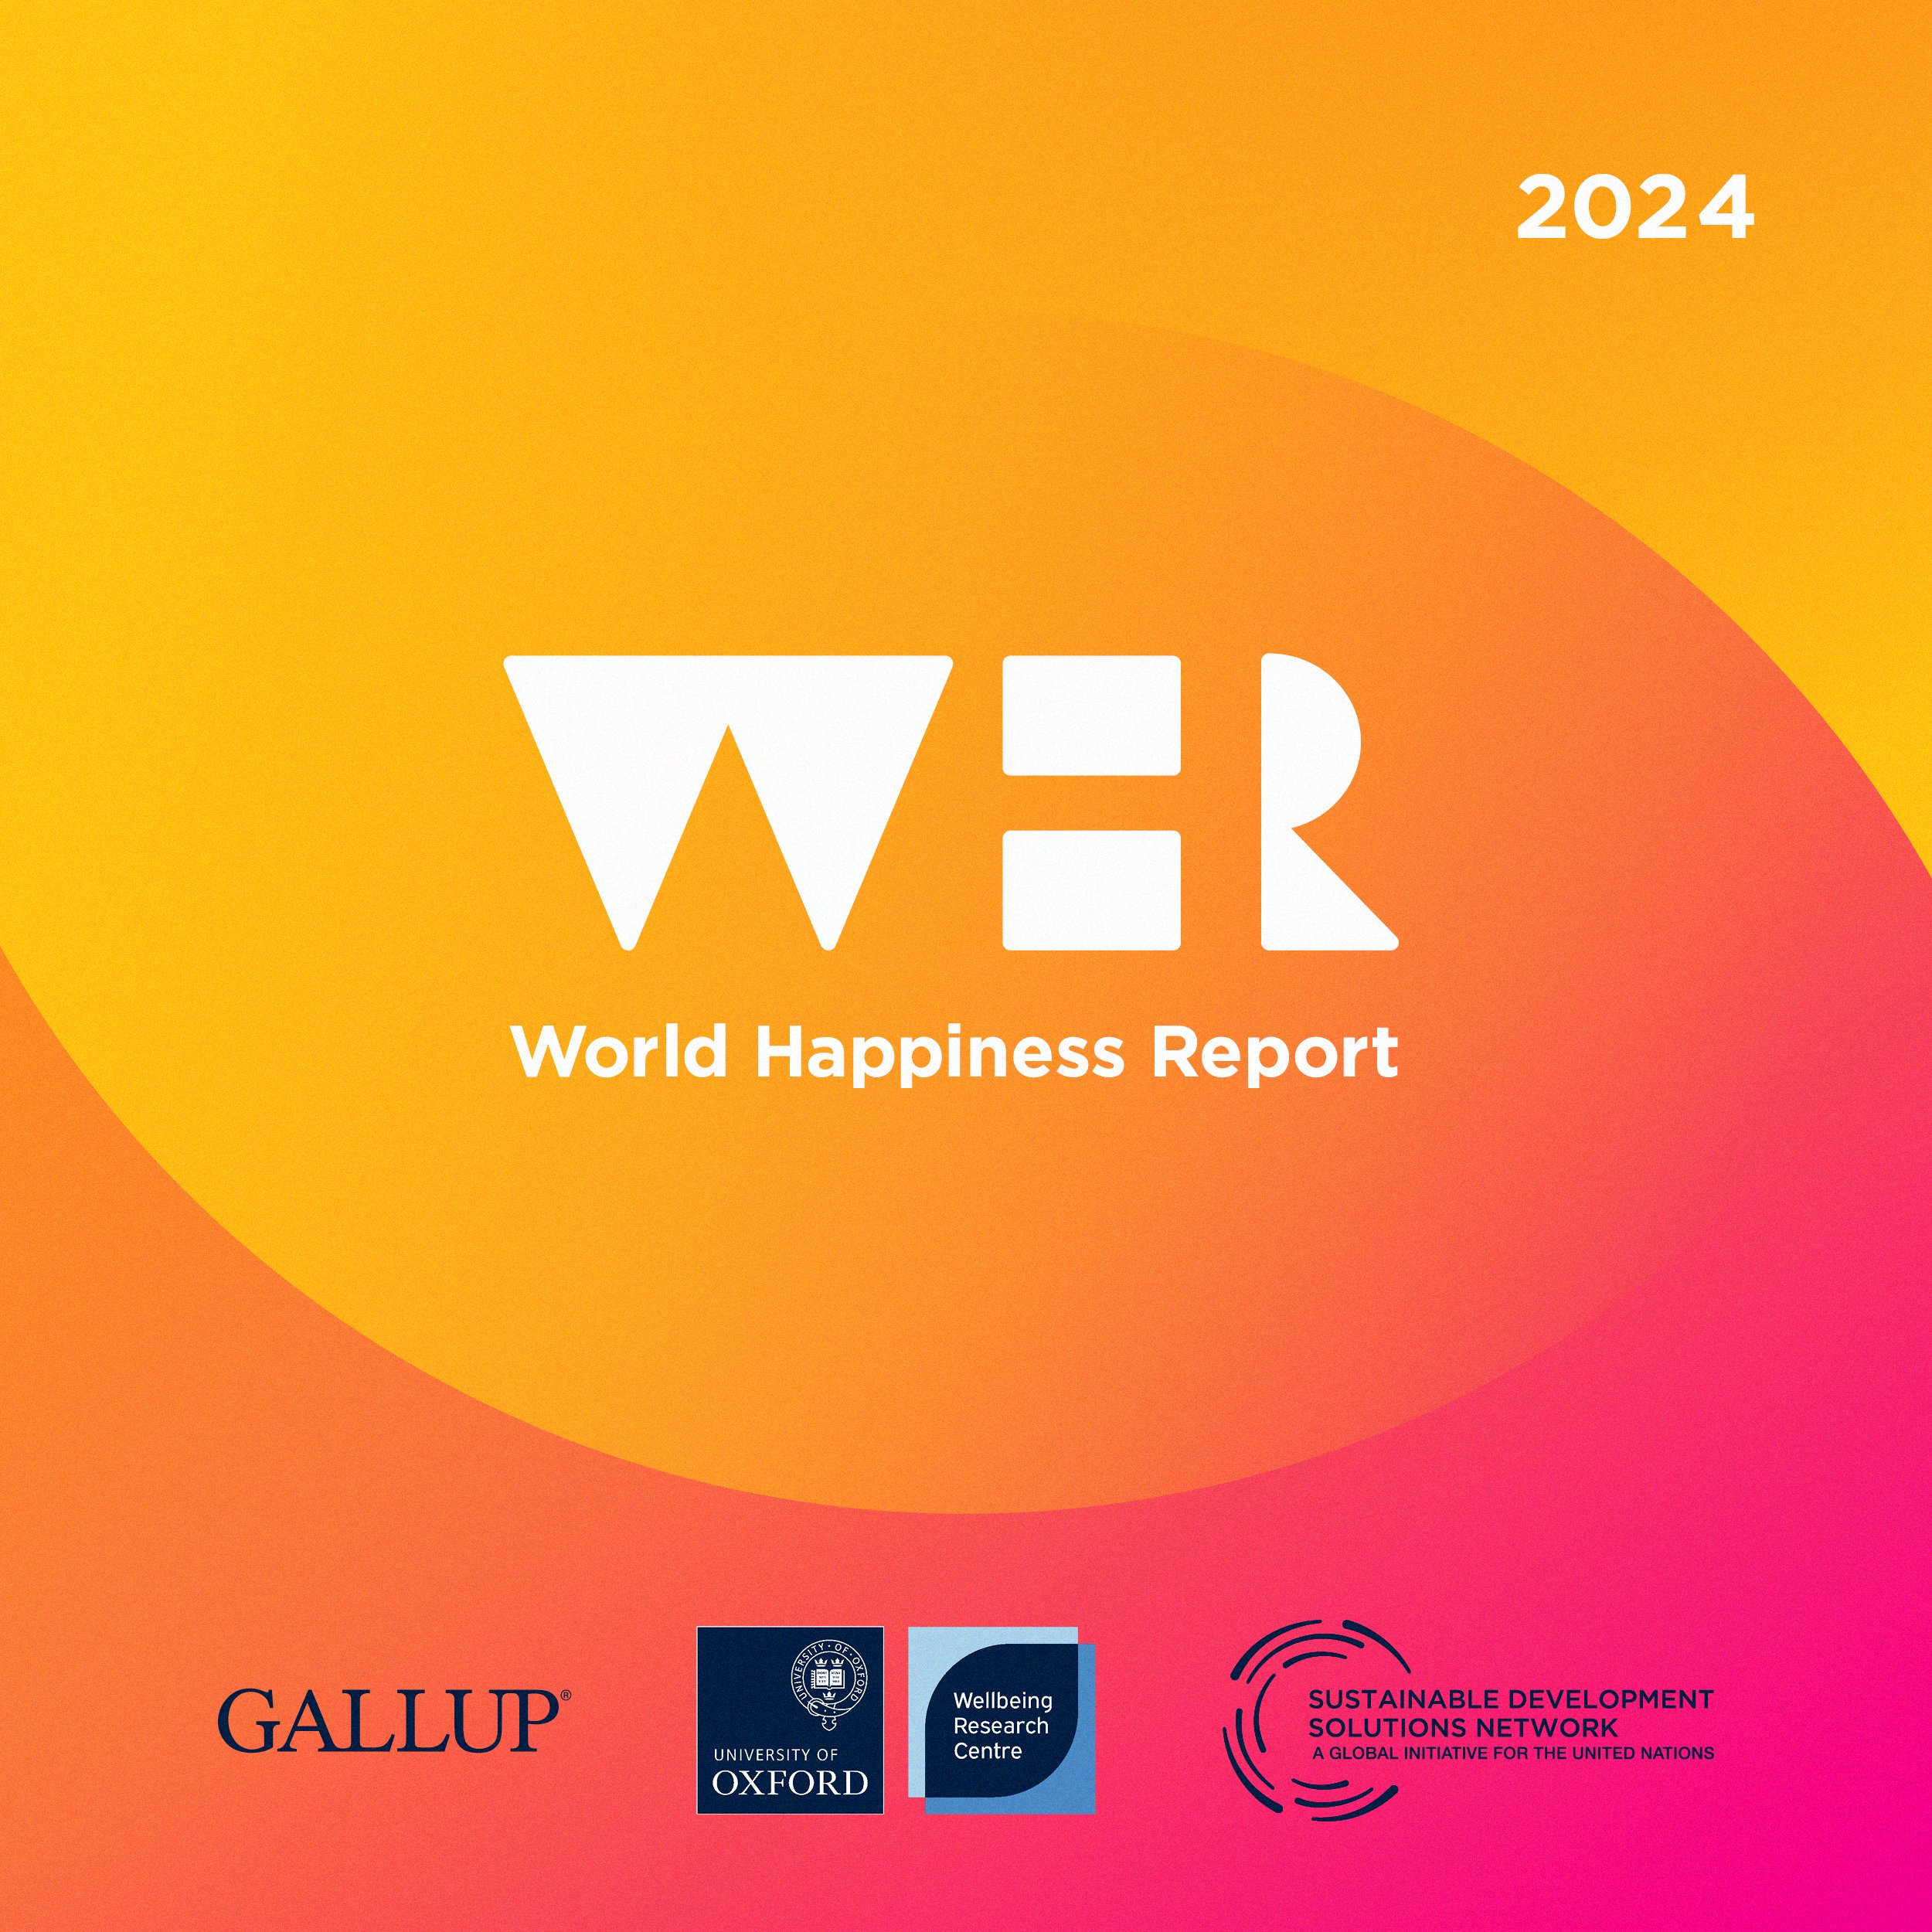
Data Collection
World Happiness Report is an annual report on the state and ranking of national happiness correlated to various qualities of life.
Published by the United Nations Sustainable Development Solutions Network starting from 2012
Participated by +- 155 countries
Used survey methodology to collect answers of real-life questions asked to respondents
Notes:
The first report was released in 2012 following the adoption of resolution 65/309 titled “Happiness: Towards a Holistic Definition of Development” by the UN General Assembly that invite members to measure the happiness of their citizens and use the data to guide public policy.
Because countries’ participation is optional, the count of countries recorded each year is not always 155, but it is an approximate number. There are 155 countries participated in 2015 and 2016, but only 154 in 2017 and 151 in 2020.
The scoring and ranking of national happiness is based on survey data from respondents collected by polling company Gallup, Inc. at the University of Oxford. Representative samples from each country are asked to rate their current lives on a 0 – 10 scale, with the best possible for them being a 10, and the worst possible life being a 0.
Experts correlates the survey results with various comparable life factors that are reflective of determinants best predicted to explain national-level differences in happiness scores.

Slide 7
Data Analysis
Performed on Tableu Public
The dataset includes 3 files joined together.
Dimensions: Country Name and Region
Measures: Happiness Score, Happiness Ranking, GDP per Capita, Healthy Life Expectancy, Social Support, Personal Freedom, and Perception of Corruption.
Notes:
There are 3 files because 1 file contains the complete set of information on countries, their happiness scores, and scores for various life factors correlated to it across the years. The other file contains data on regional attribute of the countries, and the last file provides the happiness ranking over the years measured in the project. In that way, the 3 files complete each other.
Country Name and Region are used for the dimension. Dimension here is the field or column used to categorize and provide context for measures, while measures are numerical values used for quantitative analysis of the dimension. So in this project, categorization are done by country name for some visuals, and by region for others. For each category of a given dimension , the metrics measured and analyzed in this project could include happiness score, happiness ranking, Gross Domestic Product per Capita, Healthy Life Expectancy, Social Support, Personal Freedom, and Perception of Corruption.
For every country name in the dataset, all of these measures are analyzed. These measures are all comparable life factors that represent national-level happiness determinants. GDP/capita reflects economy, healthy life expectancy reflects health, social support reflects social unity, personal freedom reflects diversity, and perception of corruption reflects trust in government.

Slide 8
Data Presentation

Slide 9
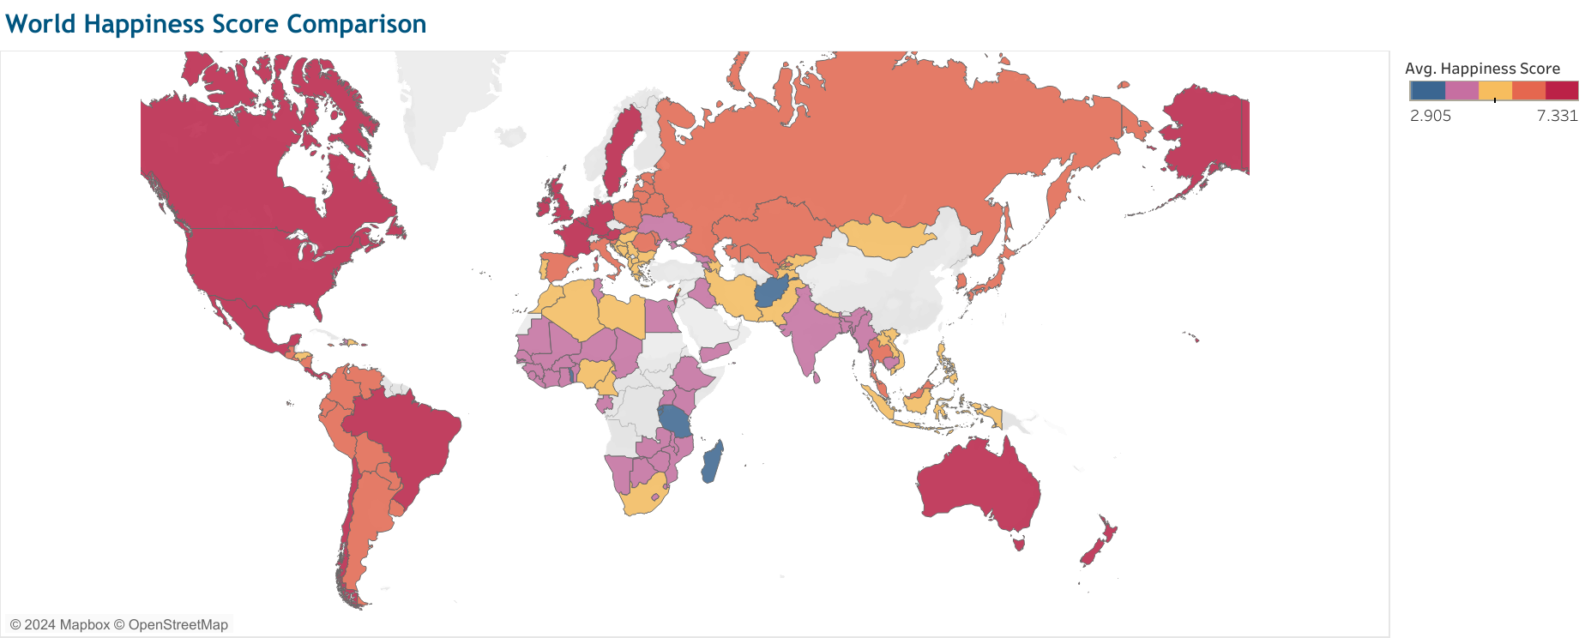
Happiness around the World….
No obvious correlation between geographical location and happiness
Countries in the same region MOSTLY have happiness score within range of each other
… because of similar Demographics
Notes:
This visual is a map chart, which is a graphical representation that display statistical data point in a geographical context.
The metric used is the average happiness score. This means the happiness scores for each country for each year from 2015 to 2020 are averaged to find a single value, which is the average happiness score.
For all countries in the dataset, the average happiness score ranges from 2.905 to 7.331. In the map chart, this metric is visualized using 5 colors ranging for dark blue that represent the lowest range of average happiness score and red that represent the highest range of average happiness score.
While there is no obvious correlation between geographical location and happiness, there is a pattern here. Countries located in the same region tend to have happiness score within the same color range, or at least the color range next to it. For example, all of United States and countries north of it are all red on the chart. Most of Asia are either yellow or pink with a few countries colored orange. This is because, all evidence suggests that geographically close countries tend to have similar demographics, especially in terms of socio-economics.

Slide 10
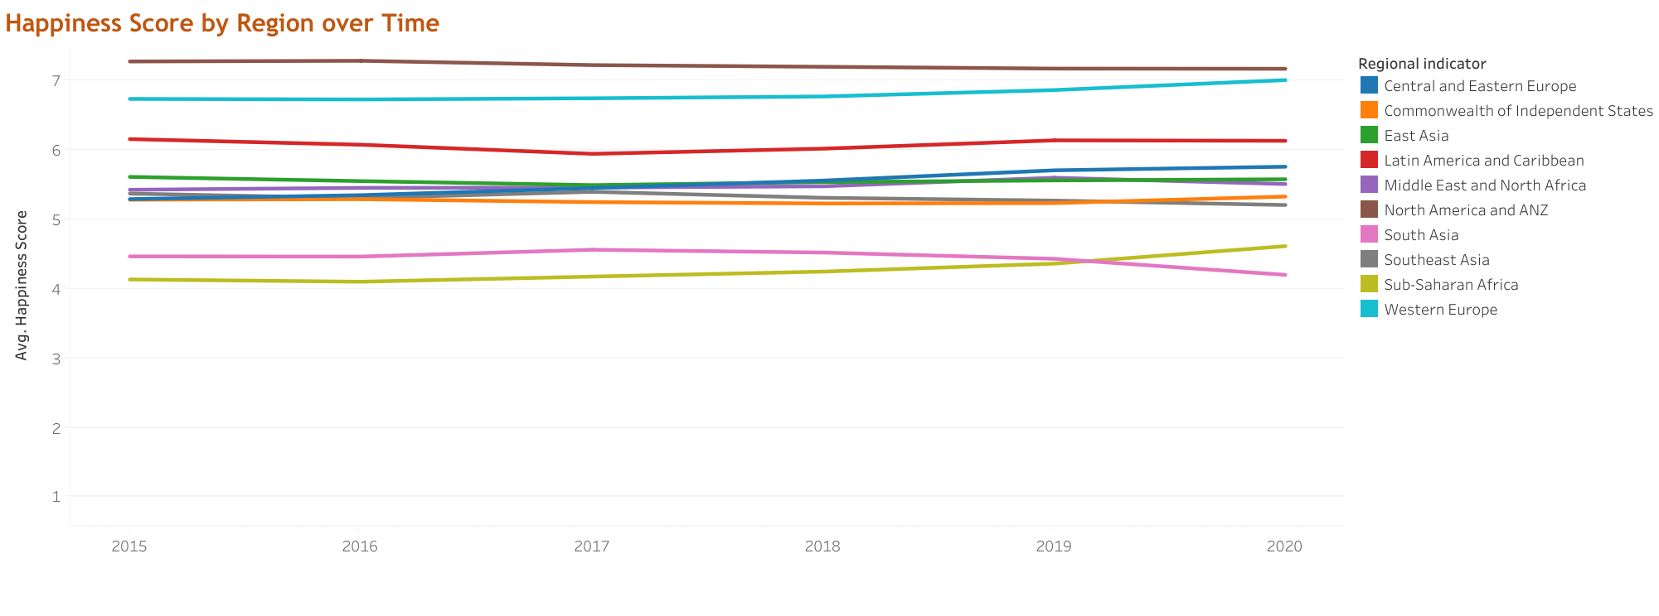
Happiness Over the Years…
Fairly consistent happiness scores for all 10 regions
Overall slight increase from 2015 to 2017 and decrease from 2019 and 2020
North America & ANZ and Western Europe regions have the highest happiness average
Sub-Saharan Africa and South Asia have the lowest happiness average
2015
2016
2017
2018
2019
2020
Notes:
This visual is a multiple-lines chart that compares the changes in average happiness score for the 10 regions included in the study over time. This project is limited to 6 years of observation from 2015 to 2020, so those are the years seen on the x-axis. The happiness score for participant countries are averaged based on their regions to get the regional happiness score for that year, which is the metric seen on the y-axis.
The annual regional happiness score is mostly consistent for all 10 regions over the years, with a pattern of slight rise from 2015 to 2017 and small decrease from 2019 to 2020. It is worth noted that the 2020 data is the least consistent compared to the rest of the years, for example the happiness score for South Asia fall significantly until it becomes the least happiest region replacing Sub Saharan Africa, which has scored the lowest happiness score from 2015 to 2019. This inconsistency could be due to the COVID-19 pandemic starting mid-year 2020 that affects nations across various regions in different time and degrees.
North America, Australia, and New Zealand region has the highest annual regional happiness score for all 6 recorded years, followed by Western Europe, which has an annual happiness score that grows significantly from 2018 to 2020.
Countries in Commonwealth of Independent States region located in the Eastern Europe and those in East Asia have the most stagnant regional happiness score above the years. Considering this is a regional happiness score calculated from many countries in those regions, it is quite interesting.

Slide 11
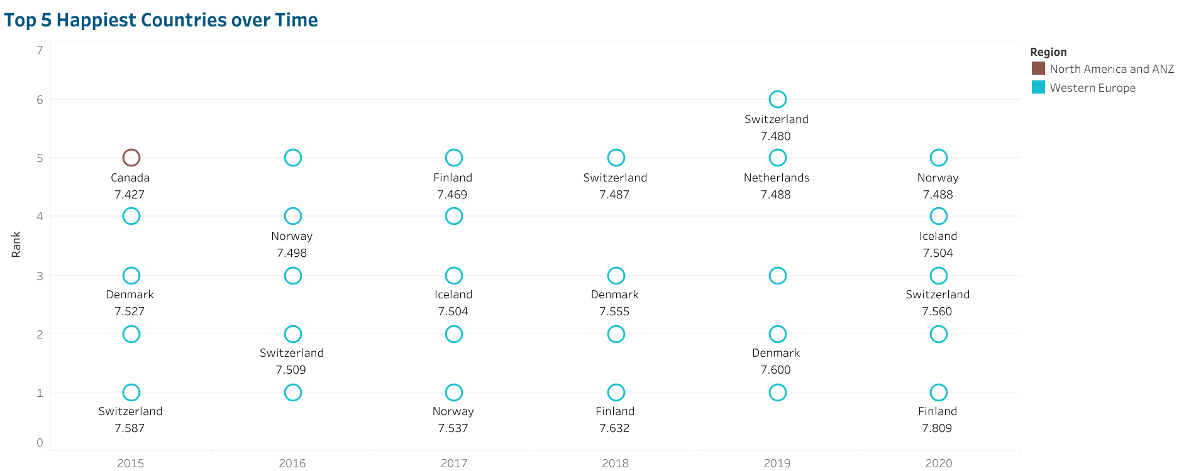
Happiness Ranking Over the Years…
Notes:
This is a dot plot that represent a fairly small set of data with data points as small circles with height of the dot represent the corresponding value measured in the-y axis, and the position of dot in the x-axis represent its category. This dot plot shows the top 5 happiest countries of each year from 2015 to 2020 using the happiness ranking as the metrics seen on the y-axis. The legend beside the chart describes the meaning for each color of the dot, which signifies region of the country.
In here, above 90% of the countries are those located in Western Europe, with only Canada belonging to the North America region. Finland, Switzerland, Iceland, and Norway are four countries that consistently appear in the “Top 5 Happiest Countries” list for the recorded years.

Slide 12
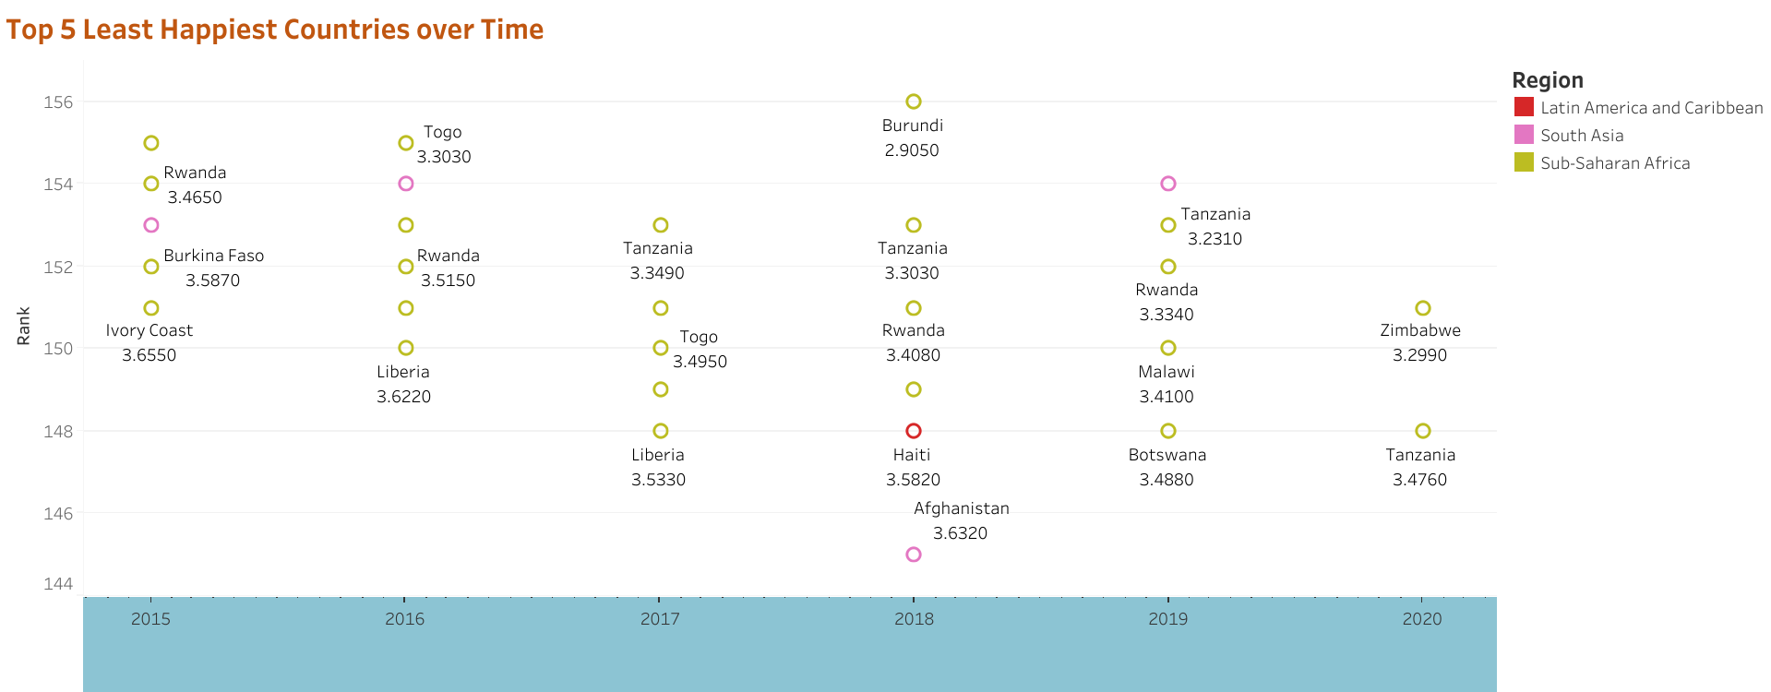
Happiness Ranking Over the Years…
Notes:
Following on the last visual, this dot plot shows the top 5 least happy countries of each year from 2015 to 2020 using the same happiness ranking as the metrics seen on the y-axis. It is noted that because the amount of countries surveyed each year are slightly different, so is the number of rankings available. For example, the lowest happiness ranking for 2015 is rank 155, while the lowest ranking for 2020 is 151.
In here, around 80% of the countries are those located Sub-Saharan Africa, the other 15% are countries from South Asia, and one country, Haiti, is from Latin America and Caribbean region. Liberia, Rwanda, and Tanzania are Sub-Saharan African countries that almost always appear at the bottom of happiness ranking list for all recorded years. Afghanistan from South Asia also consistently appear among the least happiest countries list.

Slide 13
Demographics = Happiness Factor ??
1
2
4
5
3
Perception
of Corruption
Healthy Life
Expectancy
Personal
Freedom
GDP/Capita
Social
Support
Notes:
It is time to dive into the specific demographics’ components of each country to look for the relationships, if any, between happiness and these important demographic components. As a reminder, the measurable life factors above represent the demographic components included in this project.;
GDP/Capita reflect Economic Welfare, Healthy Life Expectancy reflects Physical Health, Social Support reflects Social Cohesiveness, Personal Freedom reflects Diversity, and Perception of Corruption reflects Trust in Government.

Slide 14
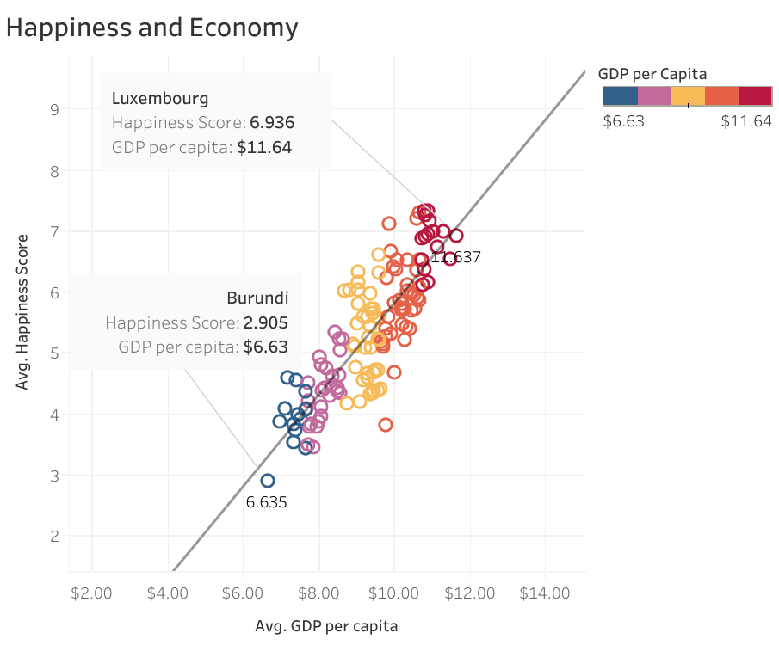
Happiness Vs GDP/Capita
Key Takeaways :
Strength of correlation is quantified by the coefficient of correlation (r)
The value of r indicates a very strong positive correlation between wealth and happiness
Luxemborg: highest GDP/capita – among the happiest countries
Burundi: lowest GDP/capita – among the least happy countries
r = 0.837530.
Notes:
This visual is a scatterplot, which identifies a possible relationship between two sets of numeric variables through visual and statistical means. The X and Y axes both plot numeric values of the two variables being analyzed, and the position of every data point on the horizontal and vertical axes indicates the value for that data point. The line that goes through the data points is the trend line, which is added to make a pattern of relationship easier to identify and quantify through statistics.
In this case, this scatterplot is used to identify and measure the strength of relationship between economic welfare and happiness of a country. The Gross Domestic Product/Capita is used to represent the economy part of the equation. Both GDP and Happiness Scores are collected annually per country, and since the study covers 6 years of observation, the values are averaged to get the Average GDP/Capita and Avg Happiness Score of each country. They are then plotted into the scatterplot and the trendline is added via Tableu tool.
Coefficient of correlation is the statistical measure of the direction and strength of a linear relationship between two variables. Its values ranges from -1 to 1 with (-) values signifying an inverse relationship, and (+) values indicating a direct relationship. The further the coefficient is from zero, whether it is positive or negative, the better the fit and the greater the correlation is, whereas a coefficient closer to zero indicates a weaker association. The extreme values of -1 and 1 indicate a perfectly linear relationship where a change in one variable is accompanied by a consistently proportionate change in the other.
The coefficient of correlation in this case is calculated by Tableu to be 0.837530, which indicates a very strong positive correlation between the two variables. As the average GDP/capita increases, the happiness level also increases in a fairly proportionate amount.
Examples that support this relationship are Luxemburg and Burundi. Luxemburg has the largest average GDP/capita and is among the happiest countries. On the opposite note, Burundi has the smallest GDP/capita and is among the least happy countries.

Slide 15
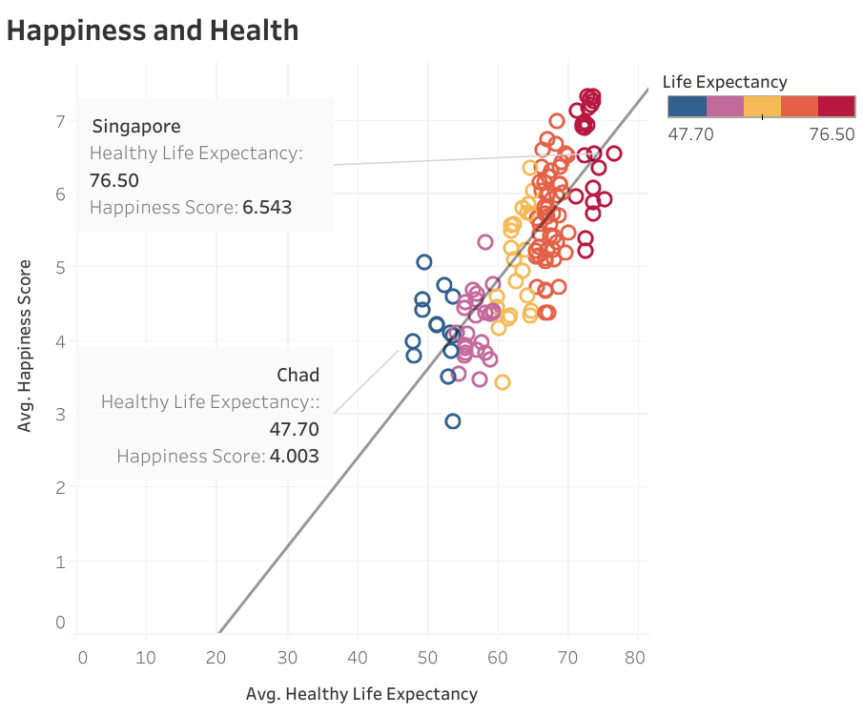
Happiness Vs Healthy Life Expectancy
Key Takeaways :
The value of r indicates a very strong positive correlation between health and happiness
Singapore: longest healthy life expectancy – NOT among the happiest country
Chad: shortest healthy life expectancy – among the least happiest country.
r = 0.811665.
Notes:
Moving on to second metric, Healthy Life Expectancy. This scatterplot is used to visualize the relationship between physical health and happiness of a country. Similar to the GDP, the healthy life expectancy is used to represent the health part of the equation.
After the Average Healthy Life Expectancy and Average Happiness Score is plotted on the scatterplot, trend line is also drawn and the coefficient of correlation is determined by Tableu to be 0.811665, which indicates a very strong positive relationship between health and happiness. Any increase in healthy life expectancy is associated with a roughly proportionate increase in happiness level.
It is noted that the country with the longest healthy life expectancy, Singapore, is not among the happiest countries, even though its average happiness score is still high. However, Chad, the country with the shortest healthy life expectancy is among the least happy country. To be fair, other countries besides Singapore that have similarly long healthy life expectancy values are mostly among the happiest countries. They are mostly countries in Western Europe region.
The fact that the coefficient of correlation between health and happiness is slightly lower than that of wealth and happiness is represented by fact that the data points in this scatterplot are also more distantly scattered from the trend line compared to the data points in wealth vs happiness that are tightly aggregated near the trend line. This infers that as strong as the relationship between health and happiness is, wealth is still a stronger predictor of happiness.

Slide 16
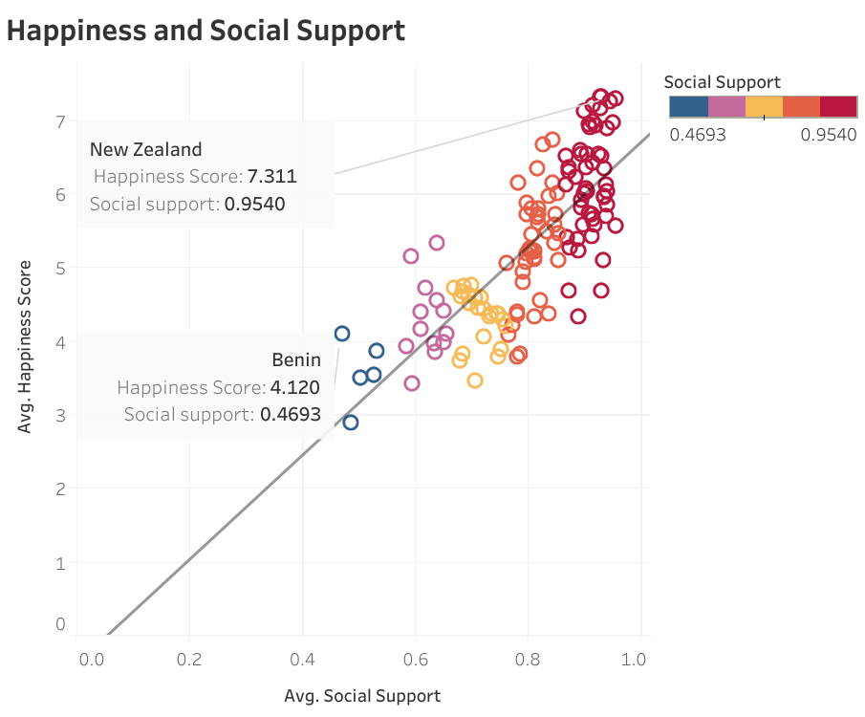
Happiness Vs Social Support
Key Takeaways :
The value of r indicates a strong positive correlation between social unity and happiness
New Zealand: largest social support – among the happiest countries
Benin: least amount of social support – among the least happy countries.
r = 0.794730
.
Notes:
The next metric is Social Support, which represents social unity as the aspect of demographics. This scatterplot and subsequent trend line visualize the relationship between the Average Social Support and Average Happiness Score for all countries.
The r value of 0.794730 indicates a strong positive relationship between social unity and happiness. This means that an increase in social support is associated with an increase in happiness level, just not as proportionately as the more stronger relationships that happiness level has with wealth and health.
Country with largest social support, New Zealand, is among the happiest countries. Similarly, Benin, the country with the least amount of social support, is also among the list of least happy countries. These examples support the strong positive relationship between social unity and happiness.
This coefficient of correlation value r is visualized by the way the data points are scattered quite distantly from the trend line, making other demographic like wealth or health better indicators to happiness level compared to social unity

Slide 17
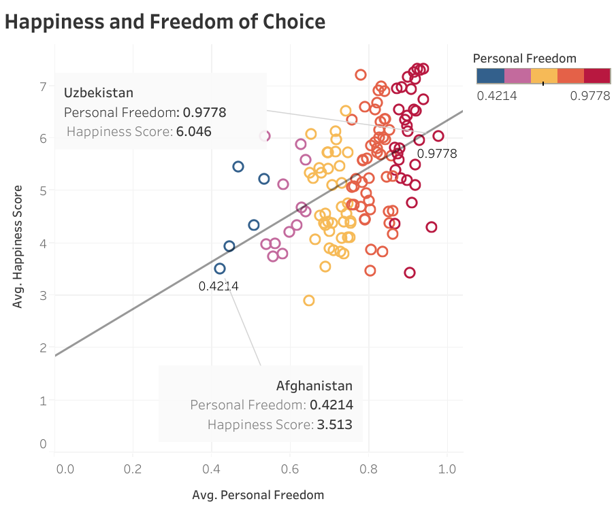
Happiness Vs Freedom to Make Life Choices
Key Takeaways :
The value of r indicates a moderate positive relationship between diversity and happiness.
Uzbekistan: highest personal freedom – NOT among the happiest countries
Afghanistan: lowest personal freedom - among the least happiest countries
r = 0.552754
.
Notes:
The fourth metric is Personal Freedom, which represents demographic diversity. To achieve a high level of freedom to make life choices, a more tolerant society is usually required, and countries with diverse population is usually among the most tolerant ones.
This Average Personal Freedom and Average Happiness Score scatterplot has a coefficient of value of 0.552754, which indicates a moderate positive correlation between diversity and happiness. This relationship is significantly weaker than the relationships happiness has with wealth, health, and social unity.
The peaks from this data points refer to Uzbekistan and Afghanistan. The highest peak of personal freedom is found in Uzbekistan, which is not found on the happiest countries list. Afghanistan, however, has the lowest value of personal freedom and is found in the least happy countries list.
The coefficient of correlation value is depicted by the way data points are scattered distantly from the trend line with many countries having a high personal freedom and lower happiness level or vice versa. The value of correlation of coefficient of almost 0.5 infers that personal freedom is not a robust predictor of happiness.

Slide 18
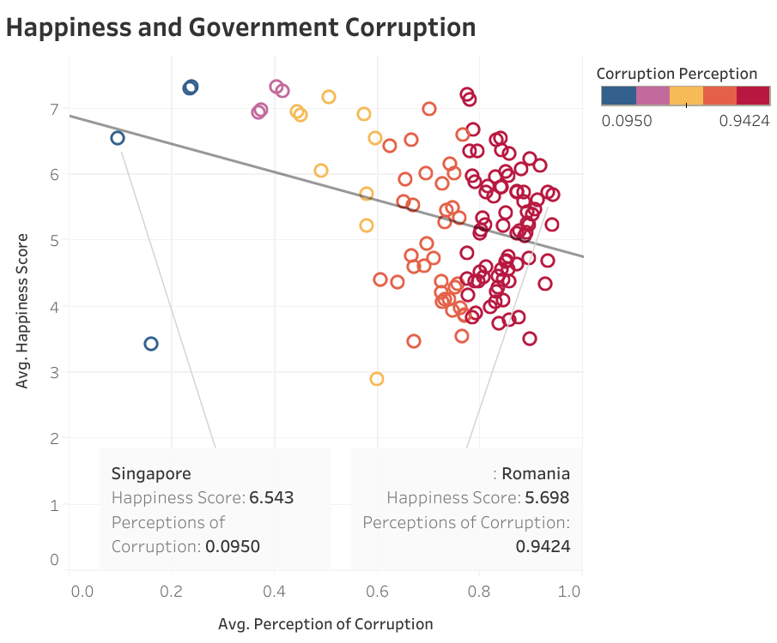
Happiness Vs Goverment Corruption
Key Takeaways :
The value of r indicates a moderate negative relationship between perception of corruption and happiness.
Singapore: lowest perception of corruption – NOT among the happiest countries
Romania: highest perception of corruption – HIGH average happiness score
r = - 0.452935
.
Notes:
The last metric discussed in this project is Perception of Corruption, which represents the trust, or lack thereof, that citizens have for their government.
The Average Perception of Corruption and Average Happiness Score scatterplot has a coefficient of correlation of - 0.452935. This negative r value indicates a moderate negative relationship between perception of government corruption and happiness score. This r value means as perception of corruption increases, the happiness level of a country decreases. In other words, the trust a country has on its government is positively associated with the happiness score of its citizen.
Country with the lowest perception of government corruption is Singapore, which is not among the happiest countries list, even though it still has a high average happiness score. The highest perception of government corruption is found on Romania, which still has a fairly high average happiness score.
Since the coefficient correlation value is less than 0.5 which is also supported by the many data points positioned remotely from the trend line, perception in government corruption is not a reliable indicator of happiness.

Slide 19
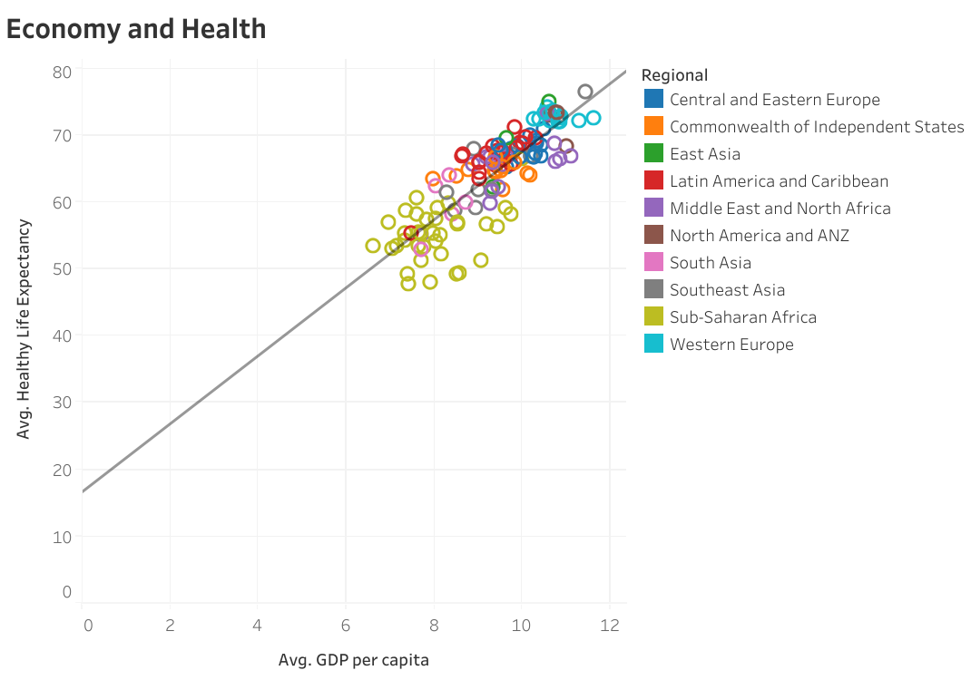
Economy Vs Health
Key Takeaways :
Strong positive relationship between Economy and Health.
Wealthy countries tend to be the healthiest
Countries in Western Europe tend to be both the wealthiest and healthiest. Countries in Sub-Saharan Africa tend to be the least wealthy and healthy.
Notes:
Since economic welfare and physical health are the two components of demographics with the strongest relationships with happiness level, they are in turn correlated on this scatterplot. It is clear that Average GDP per Capita, which represents economy welfare, has a very strong positive association with Average Healthy Life Expectancy.
Because health and wealth are very closely associated with each other, countries that are wealthiest, like those in Western Europe region, tend to be the healthiest. In the other end of the spectrum, countries in the Sub-Saharan Africa tend to have both the smallest Average GDP/Capita and shortest healthy life expectancy

Slide 20
Conclusion and Recommendation

Slide 21
Conclusions
Pattern across Region and Time
Different demographic = Different Correlation to Happiness Level.
Each demographic is interdependent with
each other
Similarity in demographics and
years of observation
In order of strength, aspects of demographic with positive association to happiness are economic welfare, physical health, social unity, diversity, and trust in government.
Wealth, Health, and Happiness are all strongly and positively correlated with each other
Similarity in happiness scores across nations
Notes:
Countries in the same region tend to have happiness scores that are within range of each other. This is true due to the fact that geographically-close countries tend to have similar socio-economic, cultural, and healthcare profiles. During the 6 years of study from 2015 to 2020 the happiness level for every region is clearly defined and relatively stable with slight increase from year 2015 to 2017 and slight decrease from year 2019 to 2020.
The relationship of each aspect of demographics and happiness level is visualized in scatterplots and quantified with the r values. The range of r value is from -1 to 1 with positive r value indicating a positive relationship, negative r value indicating a negative relationship, while the value of the indicates the degree of correlation between two variables.
Financial and physical health are demographics with r values above 0.8, which means happiness has a strong positive relationship with both GDP/capita and Healthy Life Expectancy as the metrics that represent economic and physical welfare. Although not as strong, social unity, which is represented by the metric social support, also has a fairly strong association with happiness level. The last two demographics, diversity and trust in government, have significantly weaker relationships with happiness level, both scoring r values of approximately 0.5, indicating moderate positive correlations with happiness. While diversity is represented by the metric Personal Freedom and results in a positive r value, trust in government is represented by Perception of Corruption metric and results in a negative r value. This makes sense because perception of corruption naturally translates to citizens’ distrust in the government, which is the opposite of the trust in government as the desired demographic.
The last scatterplot shows that economic welfare and health are very strongly associated with each other. Because economy and health each has strong positive association with happiness level, it can be concluded that wealth, health, and happiness tend to come as a set. Happiest countries tend to have large GDP/capita and long healthy life expectancy.

Slide 22

Recommendation
Causation between happiness and aspects of demographics, or between individual aspects of demographics
Other areas of demographics that may be indicators of happiness
Longer included time period in the study
Notes:
All relationships between happiness level and the 5 components of demographics are discussed as correlations, and not causations. This means that there is an quantifiable effect observed in the happiness score of a country when each representative metric of the demographics changes a certain amount. There is dependent relationship since changing one variable affect the other according to the direction and magnitude of the correlation. However this correlation does not translate to causation, which means that it does not mean that an increase in life expectancy, as an example, causes the increase to happiness score as an outcome.
However, very strong correlation, like the one between health and wealth, may indeed points to a cause-and-effect relationship, but it is not always the case. Further explorations are required to determine what aspects of demographic, if any, that directly lead to increase or decrease in happiness level. Since health and wealth are strongly interdependent, it is likely that most aspects of demographics also have a correlation, or even causation, to be further analyzed.
Beside the five significant components of demographics discussed in this study, there are a lot areas of demographics not yet covered, such population level, educational level, or age and sex composition in the population. It is possible these aspects of life also have correlations with happiness level that are worthy studying from.
Since this analysis only included a time period of 6 years between 2015 and 2020, it is possible that there are insights missed. Analyzing a bigger dataset over a longer time period may be necessary to get a broader picture of happiness level trends across countries over time. Covering more than a decade of data may also provide opportunities to study major changes in the metrics that is possible to occur in a given country or region during that time period, such as how the increase in education level allows people to earn more money and more medical professional to be available, which in turn we know significantly affect happiness level.

Slide 23
Thank you!

